Slide 1


Slide 2
Connections in Azure AI Studio
Marco Aurelio Cardoso
Chris Ayers

Slide 3
Agenda
Introduction to Azure AI Studio
AI Hub and Projects
Connections
Implementing RAG Chatbots
Compliance and Security Best Practices
Demo

Slide 4
Overview of Azure AI Studio
Azure AI Studio is a comprehensive platform for developing AI solutions with a focus on security, innovation, and responsible AI.
Developers can explore APIs and models, build and test solutions, deploy innovations, and manage AI solutions with monitoring and governance.
Provides enterprise-grade security and collaboration through a centralized hub.

Slide 5
Key Features of Azure AI Studio
Build Generative AI Applications: Use cutting-edge models with tools like Visual Studio Code.
Collaborative Development: Supports teamwork, shared resources, and pretrained models.
Enterprise-Grade Security: Implement role-based access control (RBAC) and governance for secure AI workflows.
Prompt Engineering: Orchestrate AI workflows and debug models using Prompt Flow.

Slide 6
Overview of Azure AI Studio Architecture
Unified Experience: Central platform for AI developers and data scientists to build, evaluate, and deploy AI models.
Top-Level Resources:
Hub: Manages security, compute resources, and connections.
Project: Isolated environments within the hub for AI development.
Connections: Integrates with Azure OpenAI, Azure AI Services, and Azure Search.

Slide 7
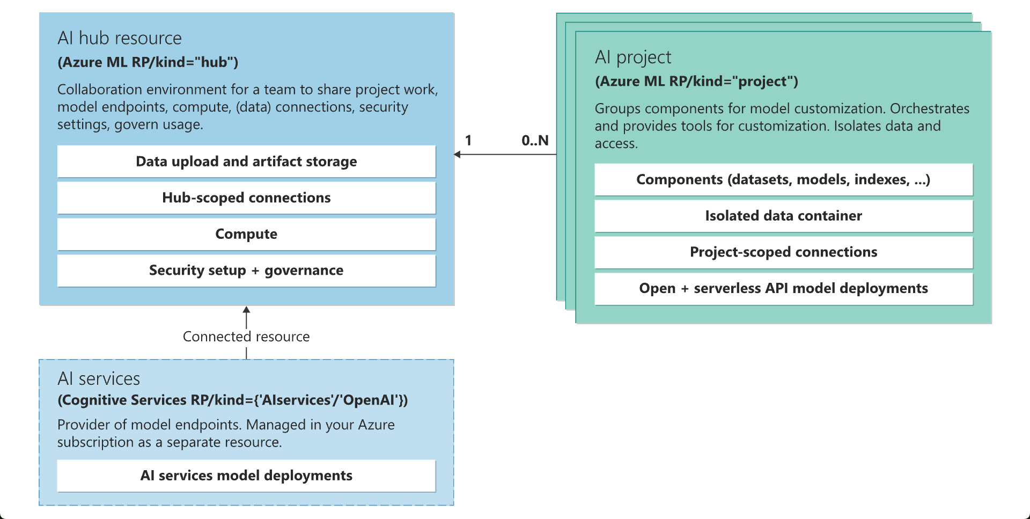
Azure AI Studio Architecture

Slide 8
Hub and Project Features
Hub Features:
Security configuration with a managed network.
Compute resources for model deployments.
Centralized management for shared resources and connections.
Project Features:
Isolated development environment with project-scoped connections.
Access to reusable datasets, models, and indexes.

Slide 9
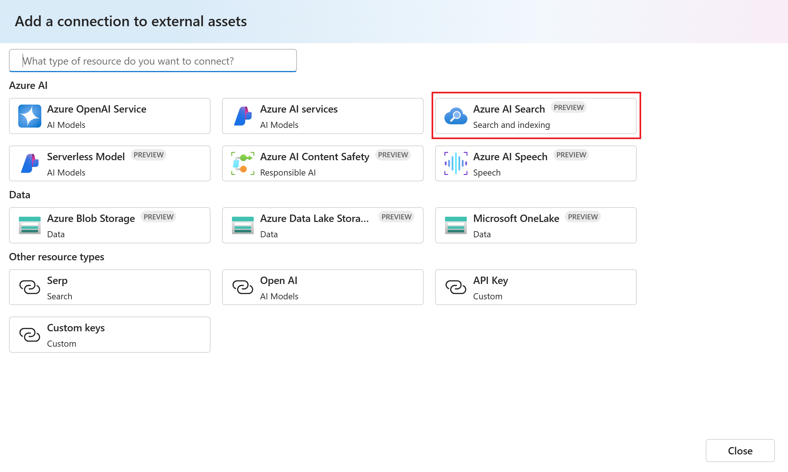
Connections

Slide 10
Storage Areas
Code: Stores scripts and code files, enabling version control and team collaboration.
Artifacts: Holds outputs from AI models, including trained models and evaluation metrics.
Data: Stores datasets for training and testing, supporting various data types and ensuring versioning.
Logs: Captures detailed operational and performance information for debugging and optimization.

Slide 11
Model Catalog
Overview
Key Features
Wide Range of Models: Includes models from Azure OpenAI Service, Mistral, Meta, Cohere, NVIDIA, and Hugging Face.
Model Collections:
Curated by Azure AI: Popular non-Microsoft models optimized for Azure.
Azure OpenAI Models: Exclusive models available through Azure OpenAI Service.
Hugging Face Models: Hundreds of models for real-time inference.
Model Deployment:
Managed Compute: Deploy models with managed compute options.
Serverless API: Pay-as-you-go billing for serverless deployment.
Capabilities:
Discover and Compare: Evaluate and fine-tune models.
Enterprise-Grade Security: Secure and govern data with built-in features.
Scalability: Integrate models into applications with scalable endpoints.

Slide 12
Access Control in Azure AI Studio
Role-based Access Control (RBAC) and Control Plane Proxy
Attribute-based Access Control (ABAC)
Separate RBAC Configurations:
Azure AI services (including Azure OpenAI) use different RBAC configurations than the hub.
Control Plane Proxy:
Simplifies Azure RBAC management.
Allows performing operations on connected Azure AI services and OpenAI resources with hub-level RBAC permissions.
Shared Storage Accounts:
Each hub has a default storage account, inherited by child projects for storing data and artifacts.
ABAC Security Model:
Defines access control based on user, resource, and environment attributes.
Per-Project Storage:
Each project has a unique Workspace ID and specific containers for storing data.
Data Encryption

Slide 13
AI Toolchain and Responsible AI
Complete AI Toolchain: Access tools for model fine-tuning, prompt orchestration, and debugging.
Responsible AI Practices: Built-in templates for designing apps responsibly, ensuring compliance and protecting privacy.
Deploy at Scale: Leverage LLMOps, monitoring, and continuous governance across environments.

Slide 14
Demos

Slide 15
Thank you!

